Slide 1
Machine Learning Skills
for ICT Professionals
SUMMARY OF ALL THE MACHINA ACTIVITIES AND RESULTS

Slide 2
MACHINA KEY PROJECT DETAILS
PROJECT CODE
BUDGET
2020-1-FR01-KA202-080386
300K €
PROJECT DURATION
FUNDING PROGRAM
28 months
Start date: 01.09.2020
End date: 31.12.2022
ERASMUS+

Slide 3
MACHINA PROJECT GOALS
Design a joint VET curriculum in ML, to empower ICT workers with sought-after technical, non-technical and meta (soft) skills.
Introduce flexible training delivery methods and innovative open access pedagogical resources to support VET provision and ML skills acquisition.
Foster the recognition and integration of ML skills requirements into sectoral competence frameworks & certification schemes.
Improve ML labour market & skills intelligence at the EU level.
The project starts in September 2020 and will finish in December 2022.

Slide 4
TARGET GROUP
I-VET students.
Sector representatives and social partners.
Public educational and
accreditation authorities.
ICT workers in need of C-VET.
Educational/Training providers.

Slide 5
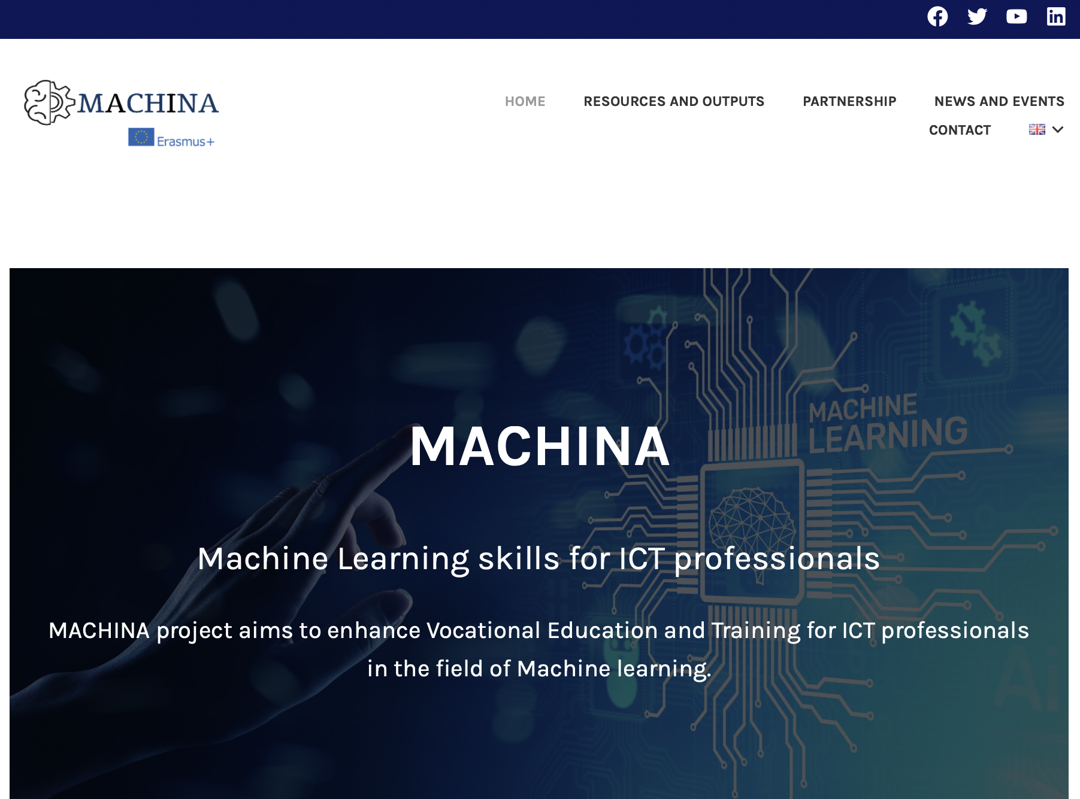
DISSEMINATION
ACTIVITIES
Logo
Website (6 languages available)

Slide 6
DISSEMINATION
Poster
Flyer
Notes:
Change the text

Slide 7
MAIN
OUTPUTS
O1
Machine Learning (ML) learning outcomes
O2
MACHINA curriculum structure and Open Educational Resources
O3
Vocational Open Online Course (VOOC) infrastructures
O4
Framework for the recognition and integration of ML skills, requirements into certification & standardization schemes
E1-E5
MACHINA National Information Days

Slide 8
O1: MACHINE LEARNING (ML) LEARNING OUTCOMES
We created tools and guidelines for skills intelligence gathering activities (O1-T1).
Collected evidence on workplace requirements regarding ML skills (O1-T2).
Defined MACHINA learning outcomes based on the analysis of the collected evidence and identifying the, knowledge, skills, and competences needed for each unit (O1-T2).
Notes:
Change the text

Slide 9
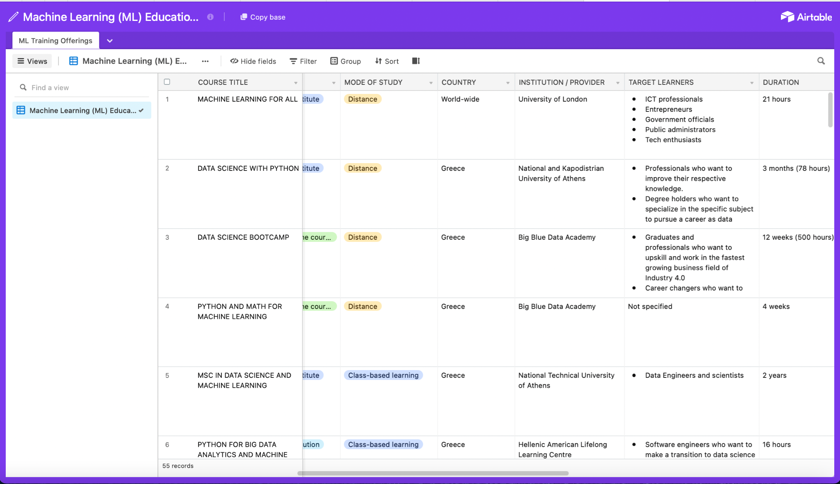
O1: MACHINE LEARNING (ML) LEARNING OUTCOMES
We have compiled a dataset of existing ML course offerings in partner countries and in the EU (O1-T3).
It provides an overview of existing training programmes and educational initiatives focused on ML related skills.
The database comprises 55 records from the 5 partnership countries (France, Germany, Italy, Greece, Romania) and beyond.

Slide 10
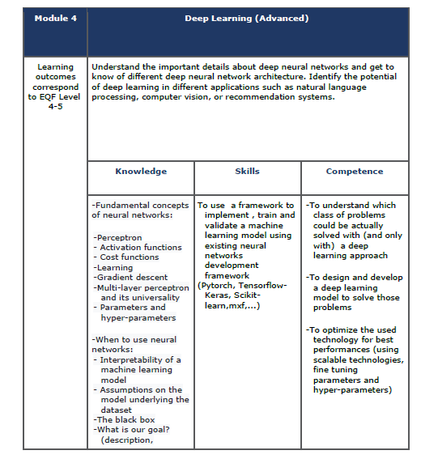
O1: MACHINE LEARNING (ML) LEARNING OUTCOMES
The report analyses the main evidence drawn from skills intelligence gathering activities and labour market investigation to define learning outcome that will make up the skeleton for the creation of a comprehensive VET curriculum on Machine Learning, to address the current and future technical and non-technical skill needs of ICT professionals. (O1-T4)
Report on Machine Learning
learning outcomes
Notes:
Change the text

Slide 11
MAIN
OUTPUTS
O1
Machine Learning (ML) learning outcomes
O2
MACHINA curriculum structure and Open Educational Resources
O3
Vocational Open Online Course (VOOC) infrastructures
O4
Framework for the recognition and integration of ML skills, requirements into certification & standardization schemes
E1-E5
MACHINA National Information Days

Slide 12
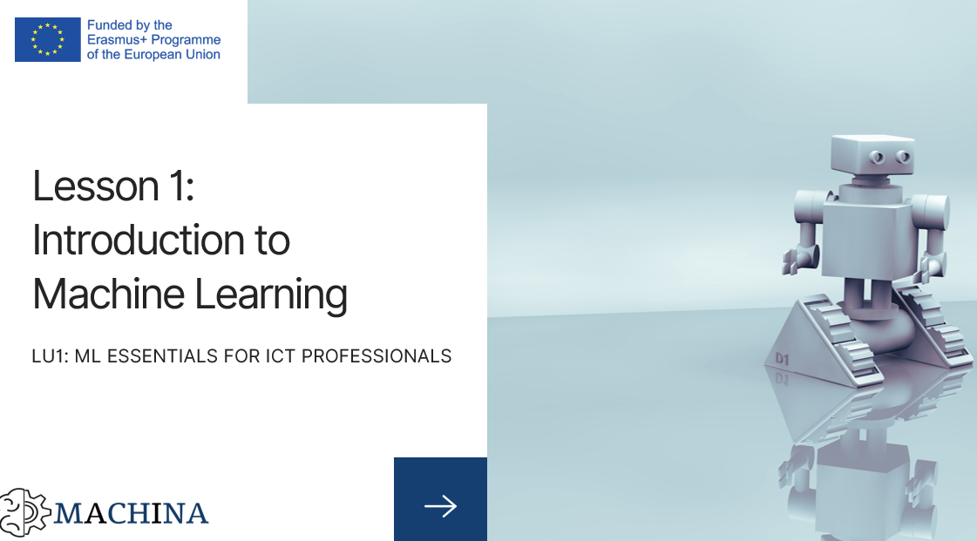
O2: MACHINA CURRICULUM STRUCTURE AND OPEN EDUCATION RESOURCES
Development of the educational resources
Curriculum characteristics:
EQF Level 5
6 Learning units
27 lessons
509 hours duration
English, French, German, Greek, Romanian, Italian

Slide 13
O2: MACHINA CURRICULUM STRUCTURE AND OPEN EDUCATION RESOURCES
Curriculum structure
LU1: ML essentials for ICT professionals
LU2: Mathematical Foundations
LU3: ML Algorithms, Programs and Protocols
LU4: Deep Learning (Advanced)
LU5: Communication
LU6: Legislation, Ethics, Project Management related to ML
Each LU unit has:
1 introductory paragraph and 3-4 pages of lecture notes for each lesson
1 presentation file with 15-20 slides for each lesson in a learning unit
10 Questions and Answers
2 Case Studies
2 practical exercises
15 multiple choice questions

Slide 14
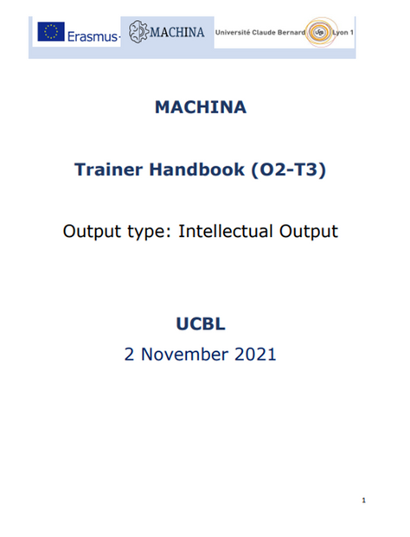
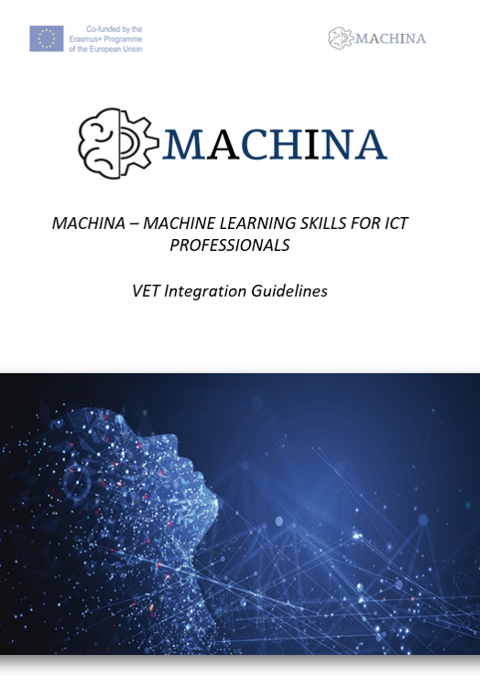
O2: MACHINA CURRICULUM STRUCTURE
AND OPEN EDUCATION RESOURCES
Open Educational Resources
VET Integration Guidelines
A report with guidelines on the introduction and integration of the developed MACHINA learning units into existing training courses for ICT Professionals.
• 122 pages of lecture notes
• 371 slides
• 76 Q&A
• 12 case studies
• 13 practical exercises
• 84 Multiple choice questions

Slide 15
O2: MACHINA CURRICULUM STRUCTURE
AND OPEN EDUCATION RESOURCES
Trainer Handbook
A complete guide for ICT trainers on how to deliver the MACHINA curriculum in formal and non-formal settings.
The guide provides instructions on how to:
a) train ICT workers (incl. I-VET students) with the use of the MACHINA educational resources
b) develop additional materials in accordance with the MACHINA learning outcomes
c) access, use and facilitate the MACHINA VOOC

Slide 16
MAIN
OUTPUTS
O1
Machine Learning (ML) learning outcomes
O2
MACHINA curriculum structure and Open Educational Resources
O3
Vocational Open Online Course (VOOC) infrastructures
O4
Framework for the recognition and integration of ML skills, requirements into certification & standardization schemes
E1-E5
MACHINA National Information Days

Slide 17
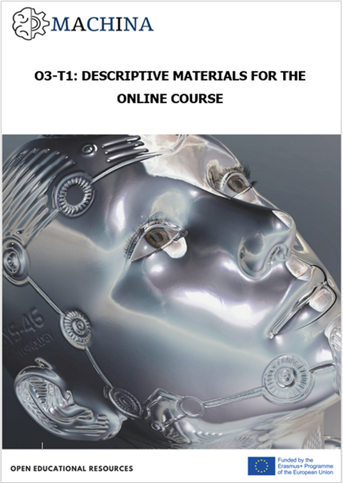
O3: VOCATIONAL OPEN ONLINE COURSE INFRASTRUCTURE
VOOC Infrastructures
The MACHINA VOOC acts as a wide access delivery method for the project’s curriculum on Machine Learning.
That’s is a flexible, self-guided e-learning scheme that reflects the structure of the MACHINA curriculum and comprises versatile training and assessment materials, including presentation files, video lectures, infographics, practical exercises, case studies, and multiple-choice questionnaires.

Slide 18
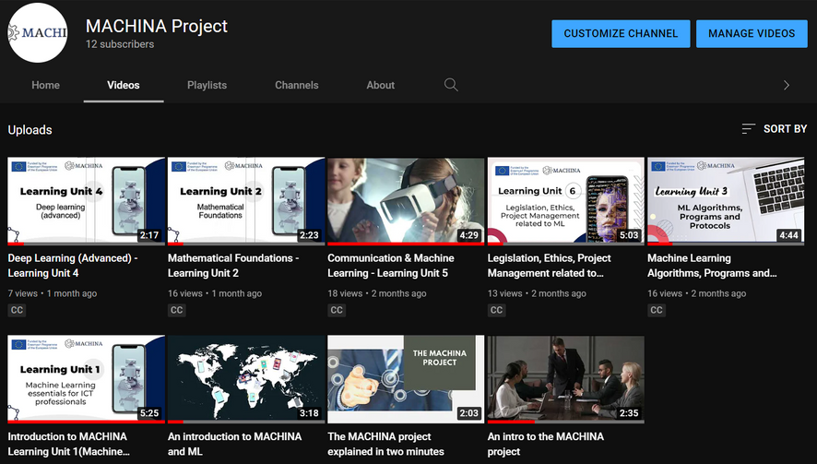
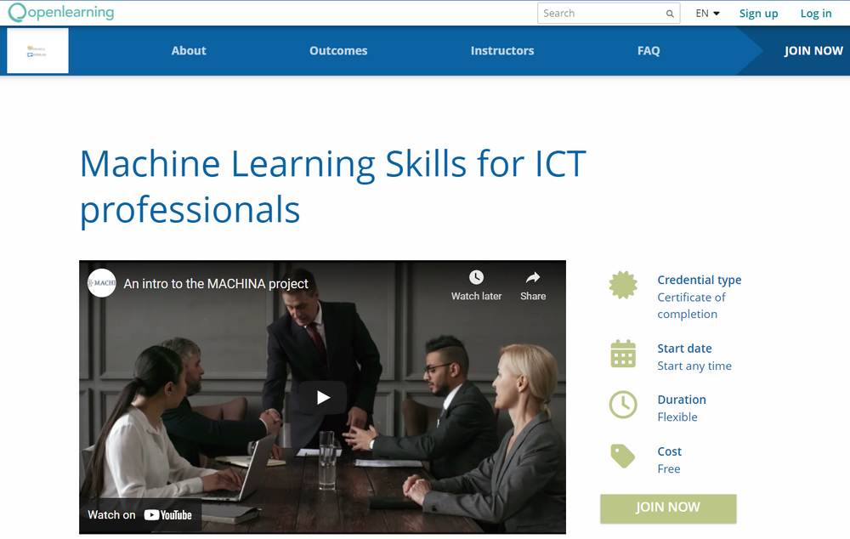
O3: VOCATIONAL OPEN ONLINE COURSE INFRASTRUCTURE
MACHINA Pilot Online Course
Videos on YouTube
It was available from 9 May to 3 June 2022. Participation in the online course was entirely free.
Videos created for each of the 6 units, which are published on YouTube and have subtitles in 6 languages.

Slide 19
MAIN
OUTPUTS
O1
Machine Learning (ML) learning outcomes
O2
MACHINA curriculum structure and Open Educational Resources
O3
Vocational Open Online Course (VOOC) infrastructures
O4
Framework for the recognition and integration of ML skills, requirements into certification & standardization schemes
E1-E5
MACHINA National Information Days

Slide 20
Framework for the recognition and integration of ML skills, requirements into certification & standardization schemes
O4:
MACHINA Online Course
MACHINA Statement of Support
The MACHINA online course is available in 6 EU languages:
English, French, German, Italian, Greek, Romanian.
It aims to motivate ML stakeholders to support the recognition of the validity of the MACHINA project’s learning outcomes

Slide 21
O4: Framework for the recognition and integration of ML skills, requirements into certification & standardization schemes
Qualification outlines (O4-T2)
Blueprint O4-T3
Specifications were defined and a certificate supplement was created.
In addition, all partners contributed to the promotion of the qualification to the competent national authorities.
The blueprint was drafted and created.
The guidelines on how to embed ML skills requirements into the EU Skills Panorama were delivered.
A campaign has been conducted to support its implementation.

Slide 22
PARTNERS
UCBL - Lyon, France
ACADEMY - Rome, Italy
ANC - Bucharest, Romania
EXELIA - Athens, Greece
L3S - Hannover, Germany

Slide 23
CONTACT
Parisa Ghodous
Professor
SOC, LIRIS UMR 5205
University of Lyon I
Email: parisa.ghodous@univ-lyon1.fr
FOLLOW US:
The European Commission support for the production of this publication does not constitute an endorsement of the contents which reflects the views only of the authors, and the Commission cannot be held responsible for any use which may be made of the information contained therein.

